Slide 1
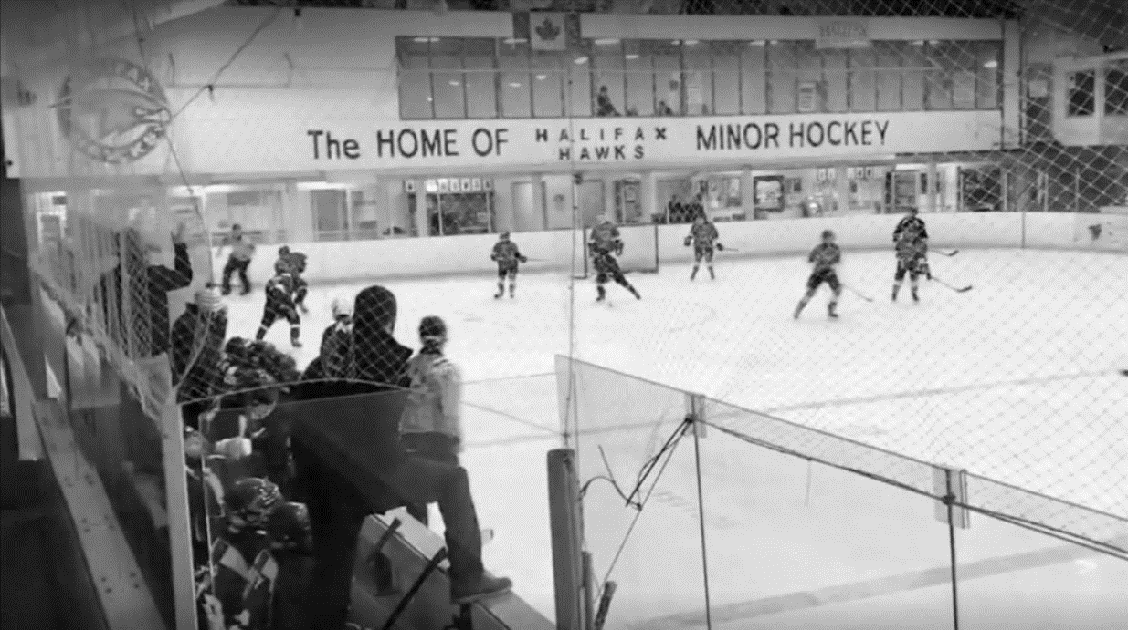
2023 / 2024 Manager’s Orientation Meeting
October 12, 2023

Slide 2
WELCOME AND THANK-YOU
Welcome
Finance
Safety & Risk
Community
Team Management an equipment
Development
Team Managers Binder:
https://www.halifaxhawks.ca/l/44/HHMHA/pages/1704/Team-Management-Resources/

Slide 3
MESSAGE FROM PRESIDENT Craig Robinson, President
Welcome back!
Thank you for your leadership
Start of season setup will lead to smooth year
Creating the right environment
Our team is here to support you

Slide 4
Finance Update Steve Maynard, VP Finance VP.Finance@halifaxhawks.ca

Slide 5
TEAM ACCOUNTS AND BUDGETS Steve Maynard, VP Finance
Teams to keep up-to-date financials, tracked by player
Bank accounts to be opened at Scotiabank on 3480 Dutch Village Road (Mandatory for competitive teams – optional for recreational)
Scotiabank expecting team representatives to visit branch on Wed Oct 18 OR Friday Oct 20 from 5-8pm.
Each team requires two signatories, and both need to attend the meeting on either of these dates (together)
Please fill out this form and return to Beth by Oct 16 at noon https://www.halifaxhawks.ca/uploads/halifaxmha/source/0/2023%2024%20Banking%20Information.pdf
No personal bank accounts or cash netting. All transactions through your team bank account
Budgets must be reviewed and approved at a team parent meeting
All budgets to be submitted by November 15th to Beth

Slide 6
Financial management basics Steve Maynard, VP Finance
Competitive and sock fees are now going to be collected internally by the bank so no worries about EFTs. Invoices will be sent per usual to teams on Nov 30 then that money will be taken out by the bank a day later.
Please let us know once you receive your invoice if you have been having trouble collecting money so we can act accordingly with the bank
A mid-year update to the parents/guardians to report progress against budget and advise families of their contributions and any projected short fall/surplus
Mid-year and year-end ice invoices in January and March (same process as above done by the bank)
Final team accounts submitted to Beth by April 30th
If you need any help organizing the year reach out to Beth or me

Slide 7
Safety & Risk Update
Important note the new requirements for safety / CPR for teams this year.

Slide 8
CERTIFICATES, REPORTS, & FORMS Beth Boyce, Operations Manager
ALL Certifications must be complete by Dec 1/23 (no exceptions)
Beginning this season ALL required courses that cost money will be paid for up front by the volunteer then reimbursed by the association, send receipt to Beth.
Certifications - https://hockeynovascotia.ca/coach/coaching-requirements
Update on further HU Safety requirements – new for the 2023-24 season
https://www.halifaxhawks.ca/uploads/halifaxmha/source/0/HU%20Safety%20and%20CPR%20UPDATED.pdf
U7 & U9 One person on each team must have HU Safety AND CSA Basic First Aid, CPR Level C and AED
U11 and up ALL volunteers are required to have HU-Safety and 1 is required to have both HU-Safety AND CSA Basic First Aid, CPR Level C and AED
The pdf above includes where you can register and where to send your current CSA Basic First Aid, CPR Level C and AED certification
Medical Information Forms
1 per player, kept by Manager, destroyed at end of year
Emergency Action Plan
Know your rink & assign roles – available on Hawks website
Complaint chain: Manager > Coach > Director > Executive VP (24 hour rule)
Any complaint going beyond this can be directed to Hockey Nova Scotia and where appropriate the Hockey Canada complaints procedure should be followed.

Slide 9
INJURIES & CONCUSSIONS Beth Boyce, Operations Manager
Log all team injuries on the Hockey Canada Injury Log (online)
Log each event with the Hockey Canada Injury Report (online)
Required for your player, coaches and spectators within 90-days
Link for injury report https://cdn.hockeycanada.ca/hockey-canada/Hockey-Programs/Safety/Insurance/Downloads/2020/2020_injury_report_hockeycanada_ns_e.pdf
Email report to HNS HRM Injury Report (online)
Email copy to HRM (Ann Wambolt or Kathleen Buntin-Brooks) and CC: admin@halifaxhawks.ca

Slide 10
INJURIES & CONCUSSIONS (CONT’D)
Due to insurance & liability concerns we need to ensure the player is cleared to be back on the ice.
Please contact the info@hockeynovascotia.ca with the following information:
Player's name
Injury or surgical procedure
Date of injury or surgical procedure
Plan for return to play
Depending on the injury/surgical procedure medical clearance may be required for return to play (form online)
Date back to full play

Slide 11
INJURIES & CONCUSSIONS (CONT’D)
HNS Return to Play must be implemented for concussion diagnosis
Return to play is gradual for concussions and only begins AFTER a doctor clears return to activity
Baseline testing
Available via a number of physiotherapists
Risk management link on Hawks website https://www.halifaxhawks.ca/l/44/HHMHA/pages/1714/Safety--Risk-Management/

Slide 12
COACHING STAFF
Coaches' helmets must be worn with chin strap snapped on and if working with multiple groups masks must be worn at all times
Please review and ensure player gear is fitted and appropriate
Sibling on-ice helpers
Must be a registered HNS member for insurance
U13 and below must be in full gear
U15 and above must wear CSA helmet with face mask and neck guard
HNS updated their discipline policy October 2021
https://5647e90c-cdn.agilitycms.cloud/Code%20of%20Discipline%20Oct%202021.pdf

Slide 13
Safety Rep Update Amy Fredericks, Safety Rep Lead
A safety representative who is not a coach or manager is mandatory for all teams.
A representative must be present during the session to ensure we are following safety protocols. When unable to be present a certified team staff member must be designated to fill in.
Any team who does not comply with this will not be approved and will not be able to continue the season.
Continued focus on making the dressing rooms safe – two deep and dressing room policies

Slide 14
Safety Rep Update (2 deep cont.) Amy Fredericks, Safety Rep Lead
At no time should a player be in the locker room alone. When players arrive they must wait for 2 certified team members before entering the locker room.
At no time should only 1 adult be present with a player.
Hawks team members are responsible for 2 deep safety 30 mins prior to sessions, and 20 mins after – meaning no player shall enter the locker room prior to 30 mins before, and must be cleared from the locker room 20 mins after.
For U7 and U9 – because parents are present in locker rooms at these levels, you must ensure that at all times 2 certified Hawks team staff members are present
With teams U13 and above who have more than one gender, you must provide 2 adults per locker room of the same gender to ensure safety protocols are in place
Teams who do not comply will face disciplinary action from both the Hawks and HNS

Slide 15
Safety Rep Update (2 deep cont.) Amy Fredericks, Safety Rep Lead
We are recommending that the safety rep lock the locker room at the start of practice, this helps to ensure players will not be unsupervised.
If a player is arriving late without pre arranging it, the expectation is that they must come fully dressed, coaching staff will be on the ice making 2 deep more difficult for some teams.
If coaches would like to step out to discuss game plans, they must ensure their safety rep and manager step in before doing so.
All “dressing room monitors” must be certified members listed on your roster. They are safety reps who are just not the teams main rep.
In the event that you require more than one safety rep (multi gendered teams), or you do not have a designated back up who is cerified, we can get one additional volunteer certified this season to assist in ensuring the 2 rule is being met. Please reach out to safetyrep@halifaxhawks.ca if you have questions.

Slide 16
Dressing Room Policy Amy Fredericks, Safety Rep Lead
The Minimum Attire Rule
To best promote inclusion and to respect the privacy of all participants on a team, Hockey Canada requires all participants to wear ‘minimum attire’ at all times in a dressing room or in dressing environments where more than one participant is present.
This means that participants should arrive at the rink wearing a base layer (e.g., shorts and t-shirt, compression shorts and shirt or sports bra). A participant not arriving at the rink wearing their base layer can use an appropriate private space (e.g., private restroom stalls or empty/unused dressing rooms) to change into the base layer and then enter the team dressing room with the other participants.
Specific rules for those who shower

Slide 17
Dressing Room Policy - FAQ Amy Fredericks, Safety Rep Lead
Q1. I currently wear a T-shirt but only underwear on the bottom with a jock in shorts?
A1. You could move to wearing a base layer or you will need to go to the washroom to get ready including putting on your hockey pants.
Q2 I currently wear Under Armour but with a jock built in?
A2. This would constitute minimum attire
Q3. I don’t wear a t shirt under my gear?
A3. You can consider wearing a t-shirt or go to the washroom to put your shoulder pads / chest protector and jersey on.
Q4. My team / group is a single gender do we have to follow these rules?
A4. Yes – all groups need to follow these rules at all times.

Slide 18
EMBRACE DIVERSITY & INCLUSION
Consistent with the Hawks’ Values and Code of Conduct, the Hawks supports Hockey Nova Scotia’s Diversity and Inclusion Task Force
https://hockeynovascotia.ca/about-us/hockey-lab/diversity-and-inclusion-task-force
All Hawks members (players, parents, coaches, etc.) are prohibited from making inappropriate statements, comments or ‘slurs’ based on any prohibited ground of discrimination under the Nova Scotia Human Rights Act (i.e. inappropriate gender-based, sexual-orientation based, race-based comments, etc.);
The Hawks will investigate such statements, comments or slurs as a violation of our Code of Conduct and take remedial or disciplinary action, where appropriate.

Slide 19
OTHER SAFETY & RISK
First aid kits must be purchased and available at all team events
See website for first aid kit minimum requirement
No sharing of water bottles

Slide 20
Player / Supporter / Spectator Code of Conduct
This is included on the jersey waiver which will be signed by parents (options for u7/u9 and u11c)
As a Parent/Supporter, I commit to:
Understanding that this is a game played by children for their enjoyment and development.
Encouraging fair play, to play by the rules, and for my child to resolve conflict without resorting to hostility or violence.
Understanding that, other than our Technical Director, there are no hockey professionals on the ice or benches, therefore should not be judged by professional standards; This includes players, coaches, timekeepers, and officials.
Observing the 24-hour ‘cool down’ period before I discuss any serious concerns I have with a coach before communicating through the team manager in a professional way.
Recognizing that diversity in hockey helps decrease the chance of discrimination; We
will not use derogatory, demeaning, or discriminatory language that is based on another person’s identity; this includes but is not limited to, racist, homophobic, transphobic, misogynistic, and sexist language.
Intervening and/or reporting incidents of racism, discrimination, harassment, or any action that affects the safety of another individual to a referee, coach, parent/guardian, or the Association.
Recognizing that without officials there is no hockey. We commit to never abuse or degrade any official, and recognize officials are being developed in the same manner as players.
Remembering that children learn by example. We will applaud good plays and performances by both my child's team and their opponents.
Understand the Hockey Canada dressing room policy and will make sure that my player complies with it to enable everyone to take part.
Acknowledging that failing to uphold the values and expectations of this pledge can result in consequences levied by Hawks Association to ensure respect and the enjoyment of the sport for all.

Slide 21
Hawks Pledge
Αλλ τεαμσ μυστ χομπλετε ανδ σενδ α σιγνεδ χοπψ το εξεχυτιϖε.ϖπ≅ηαλιφαξηαωκσ.χα
Ηαρδ χοπιεσ αϖαιλαβλε φρομ τηε Ηαωκσ Οφφιχε
Νεεδ το βε δισχυσσεδ ανδ σιγνεδ βψ αλλ πλαψερσ / χοαχηεσ ανδ ϖολυντεερσ ον α τεαμ – συππορτ αϖαιλαβλε φρομ βοαρδ μεμβερσ ωηερε ρεθυιρεδ
Αγε αππροπριατε
Θυεστιονσ το εξεχυτιϖε.ϖπ≅ηαλιφαξηαωκσ.χα

Slide 22
Community Update Kate Udle, VP Community (vp.community@halifaxhawks.ca)

Slide 23
FUNDRAISING
All fundraising efforts are encouraged but should follow Hockey Canada’s guidelines for off-ice and insurable events
Events should be reviewed and approved by the Board
Any event uninsurable by Hockey Canada cannot be affiliated as a Hawks fundraiser or event
Visit Hockey Canada’s sanctioning guide for a list of activities
Sponsorship is also encouraged as long as
The Hawks have no association level sponsor with conflicts
Cannot use liquor, tobacco, or drug enhancing companies

Slide 24
50:50
One draw each month until end of February:
October 31, November 30, December 30, January 31, February 29
All players have individual links to sell funds, which you should have now received from Rafflebox.
Sales up to the end of January can be used against team costs for the year
Hawks will be able to arrange transfers on behalf of players to team accounts
Sales for Feb-March will go towards registration next year

Slide 25
Financial Support (vp.finance@halifaxhawks.ca, vp.community@halifaxhawks.ca)
There are number of support programs available to help with fees, please check the Hawks website
The Player support fund is the Hawks funding where we are able to offer limited support to members who need help.
This can be used for team costs or if a player requires some equipment.
Members can apply in confidence via e-mail vp.community@halifaxhawks.ca and vp.finance@halifaxhawks.ca with a brief explanation

Slide 26
HAWKS SOCIAL MEDIA
We are trying to engage with members and fans by leveraging social media for additional communications in line with our social media policy
If Teams would like to create any awareness of team events, send pictures with description to admin@halifaxhawks to appear on social media channels
Important game notices, big game wins, sponsorship recognition, other fun shoutouts
Please have consent from families before sending
Hawks social media handles:
Facebook: @HalifaxHawksMHA
Instagram: @HalifaxHawksMHA
Twitter: @HfxHawks
We also encourage Team Social Media and will reshare posts where we can so follow and tag us

Slide 27
HAWKS GIVE BACK & HAWKS DAY
We will be hosting a community outreach event in connection with the holiday season, and teams will be encouraged to get involved. Stay tuned for more details!
Hawks Rawk The Rink will also be back this year! More information to follow.
We are planning an end of season Hawks Day – watch this space!
Fundraising will be needed to support making Hawks Day happen
We are always looking for opportunities for members to get more involved in the community in which we live and play. Any ideas for how teams could support this please contact vp.community@halifaxhawks.ca

Slide 28
Team Management and equipment Update

Slide 29
TRAVEL PERMITS Beth Boyce, Manager Association Operations
In order to receive a travel permit for your team, you must:
Be registered with the team you are associated with (like a team manager or coach)
Have a HCR 3.0 account.
To request a travel permit, you must be rostered with your team.
Travel permits are pre-approved. You are not required to wait for the travel permit to say approved.
If the travel permit that you applied for comes back as rejected, please contact your Minor Council Regional Director, Mike Strong (mstrong@hockeynovascotia.ca)for further information.

Slide 30
CLEVE’S ORDERS Jens Grodt, Equipment Manager (equipment.manager@halifaxhawks.ca)
Cleve’s orders can be:
Completed online https://halifaxhawks2022.itemorder.com
Through the Cleve's Team sale office in Burnside
Via email using the order form. Simply complete the order form (see Hawks’ website) and email the information to:
Rose Boutilier at Cleve's at teamsales@cleves.ca or at (902) 468-6520 Extension 226
Visit the store for any sizing requirements
Special coaches order form available online
Visit the Hawks’ website for more info on purchase and discounts

Slide 31
RESOURCES Beth Boyce, Manager of Association Operations
All content here is featured on our website
For Manager Resources visit HalifaxHawks.ca and click the Managers Resources link
For the Halifax Hawks Policy Manual sections visit HalifaxHawks.ca and go to: Regulations > Policy Manual
For the Risk and Safety Resources visit HalifaxHawks.ca and click the Risk Management link

Slide 32
Go Hawks Go!

